Slide 1

DIYALA UNIVERSITY
COLLEGE OF ENGINEERING
DEPARTMENT OF COMMUNICATIONS ENGINEERING
Electronic Circuits I
Second stage_ Lecture 5
By
lectural
Wisam Hayder
2020 - 2021

Slide 2
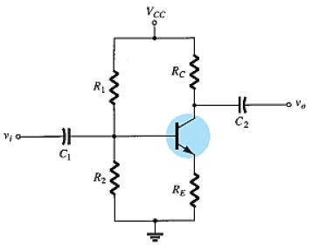
3. Voltage-Divider Bias Circuit:
Analyses:
Fig. 7 a shows a voltage-divider bias circuit.
For the input (base-emitter circuit) loop:
(a)
Fig. 7
Notes:
aaa

Slide 3
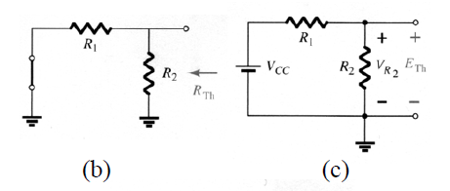


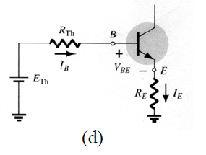
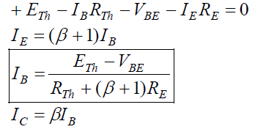
Exact Analysis
From Fig. 7 b:
From Fig. 7 c:
From Fig. 7 d:
7 a
7 b
7 c
Notes:
aaa

Slide 4
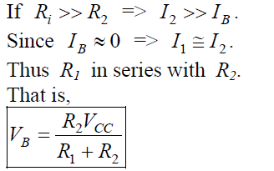
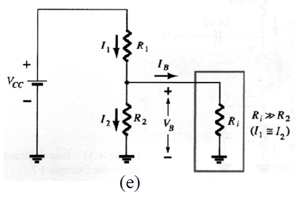
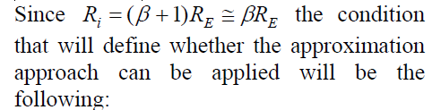
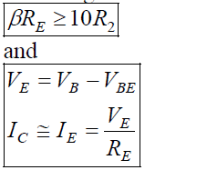
Approximate Analysis:
From Fig. 7e:
8 a
8 b
8 c
Notes:
aaa

Slide 5

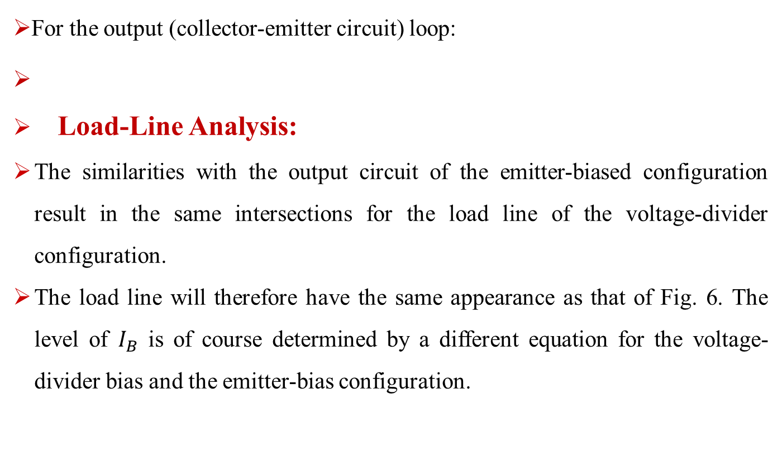
Approximate Analysis:
For the output (collector-emitter circuit) loop:
Load-Line Analysis:
The similarities with the output circuit of the emitter-biased configuration result in the same intersections for the load line of the voltage-divider configuration.
The load line will therefore have the same appearance as that of Fig. 6. The level of $I_{B}$ is of course determined by a different equation for the voltage-divider bias and the emitter-bias configuration.
9
Notes:
aaa

Slide 6
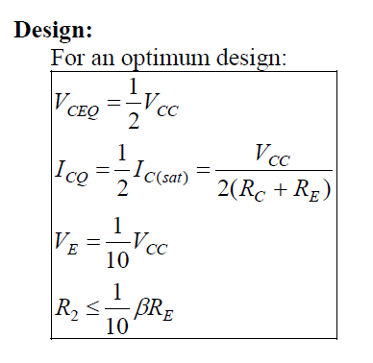
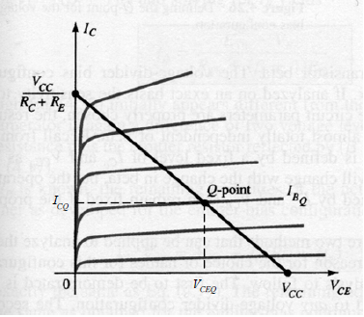
Design:
10
Fig. 6
Notes:
aaa

Slide 7
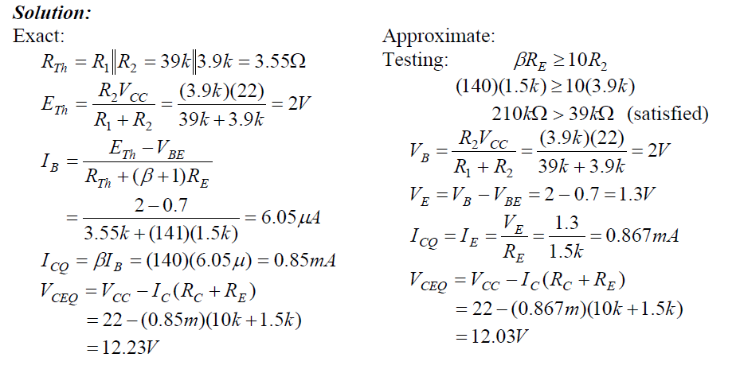

Example:
Determine the dc bias voltage $V_{CE}$ and the current $I_{C}$ for the voltage-divider configuration of Fig. 7 a with the following parameters: $V_{CC}$ = +22 V, β = 140, $R_{1}$= 39 kΩ, $R_{2}$ = 3.9 kΩ, $R_{C}$= 10 kΩ, and $R_{E}$= 1.5 kΩ.
Notes:
aaa

Slide 8
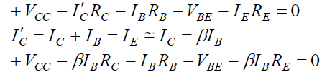
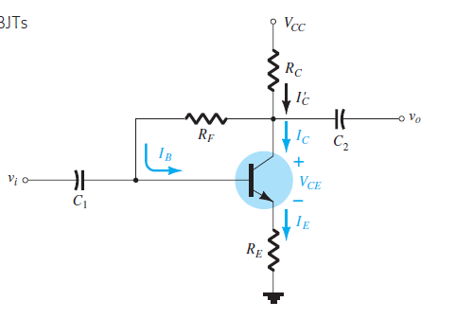

4. Voltage-Feedback Bias Circuit:
Fig. (8a) shows a voltage-feedback bias circuit.
Analysis:
For the input (base-emitter circuit) loop as shown in Fig. 8b:
(11 a)
(b)
Fig. 8
Notes:
aaa

Slide 9
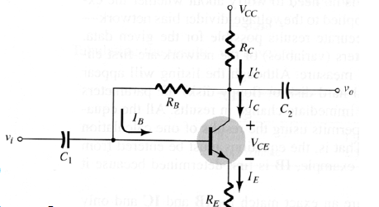
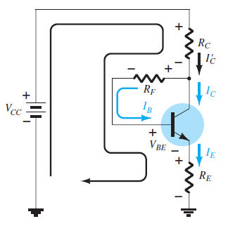
Analysis:
(a)
(b)
Fig. 8
Notes:
aaa

Slide 10
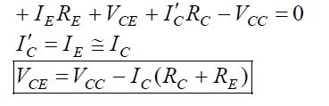
2. Emitter-Stabilized Bias Circuit:
For the output (collector-emitter circuit) loop as shown in Fig. 8 c:
(11 b)
(c)
Fig. 8
Notes:
aaa

Slide 11
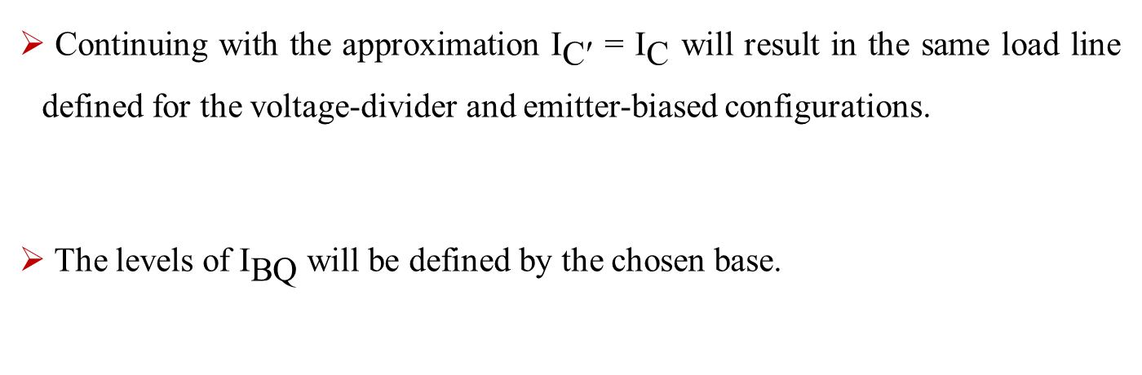
Load-Line Analysis:
Continuing with the approximation ${\text{I}}_{\text{C}\text{′}}$ = ${\text{I}}_{\text{C}}$ will result in the same load line defined for the voltage-divider and emitter-biased configurations.
The levels of ${\text{I}}_{\text{BQ}}$will be defined by the chosen base.
Notes:
aaa

Slide 12
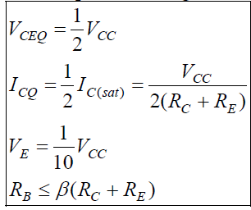
Design:
For an optimum design:
12
Notes:
aaa

Slide 13
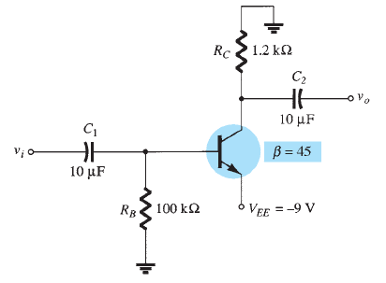

Other Biasing Circuits:
Example: (Negative Supply)
Determine $V_{C}$ and $V_{B}$for the circuit of Fig. 9.
[Fig.9]
Notes:
aaa

Slide 14
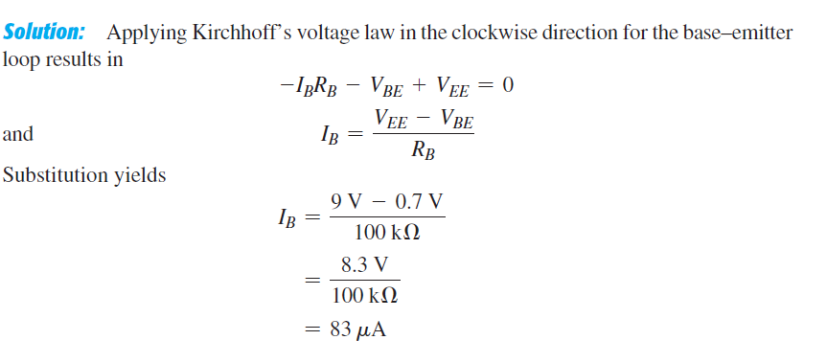
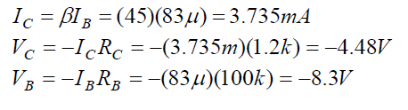
Load-Line Analysis:
Notes:
aaa

Slide 15
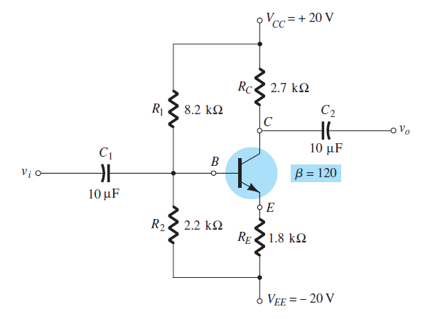

Design:
Example : (Two Supplies)
Determine ${\text{V}}_{\text{C}}$ and ${\text{V}}_{\text{B}}$ for the circuit of Fig. 10 a.
Fig. 10 a
Notes:
aaa

Slide 16
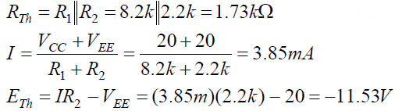
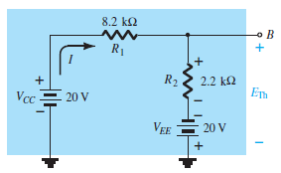
Examples
From Fig. 10 b
[Fig.10. b]
Notes:
aaa

Slide 17
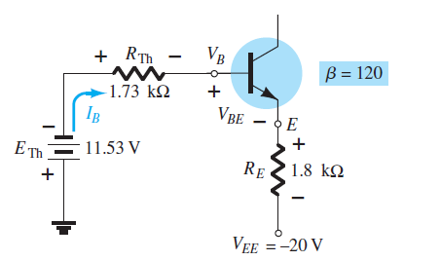
Examples
From Fig. 10. c:
[Fig.10. c]
Notes:
aaa

Slide 18
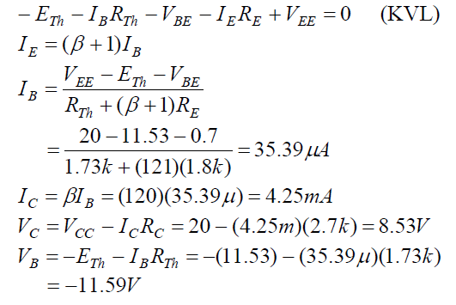
Examples
Notes:
aaa

